Slide 1

Fight Utopia

Slide 2
Idea of Game
The Main idea of the game is to have an open world game. Where players can fight against any character in the world and have that character fight back.
I would like to have the layout of the game similar to some of my favourite games like assassins creed or Batman Arkham series.
I would like character to randomly generated as the player moves around the map.

Slide 3
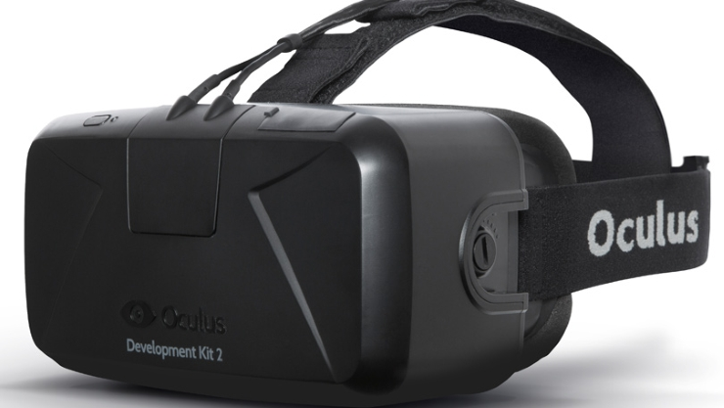
Technology
In my game I am making the game compatible with oculus rift. This is a device that players will wear and create a feeling of being in the virtual world that is created.

Slide 4
Architecture
The player will start the game and be asked to select a difficulty to play. Then they will play through a tutorial showing them the controls and give them their first look into the games world.
The players stats will be saves as they level up or at certain points in the game. When the plyer return to a fast travel point they have unlocked.

Slide 5
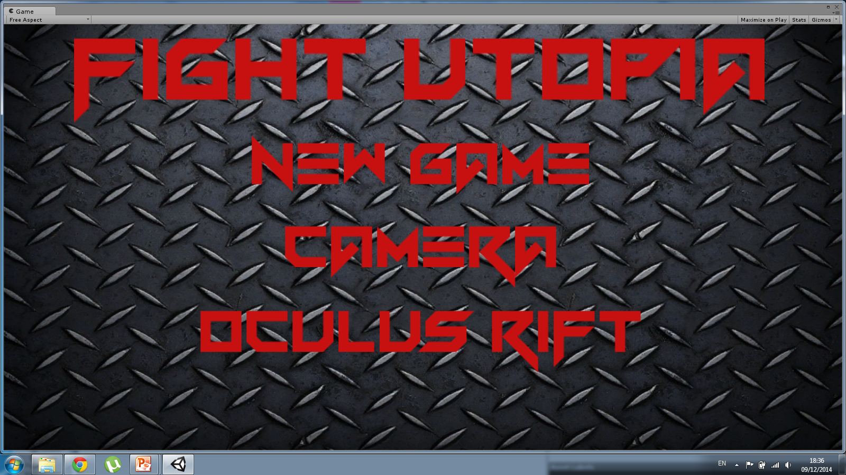
GUI

Slide 6
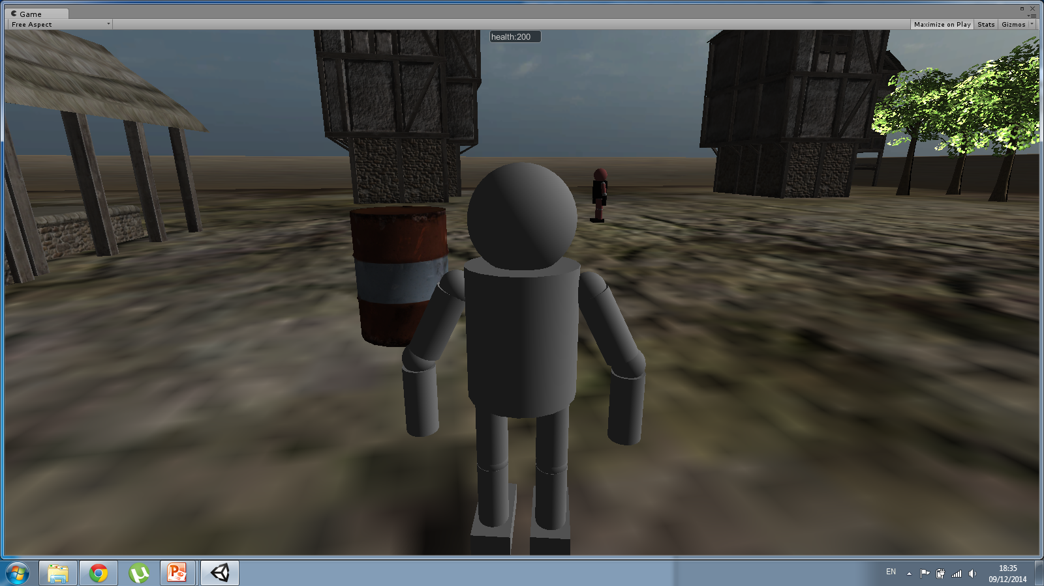
GUI continued

Slide 7
Plan
Create realistic animations.
Develop better AI.
Improve on my combat system.
Add inventory system.
Improve on models and textures.

Slide 8

Questions

